Slide 1
Food for thought
27.11- 03.12.2022
Kalamata

Slide 2
CLIL LESSON: BIODIVERSITY AND SUSTAINABLE DEVELOPMENT
Lessons about biodiversity and sustainable development have been conducted
We have prepared posters to familiarize all the students with the ideas of biodiverity and sustainable development
We have watched films to learn more about the subject

Slide 4
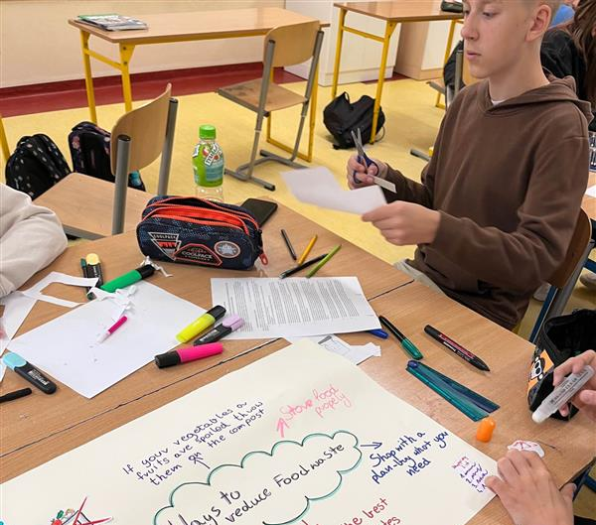
Project work
We have prepared posters about biodiversity and sustainable development.

Slide 5
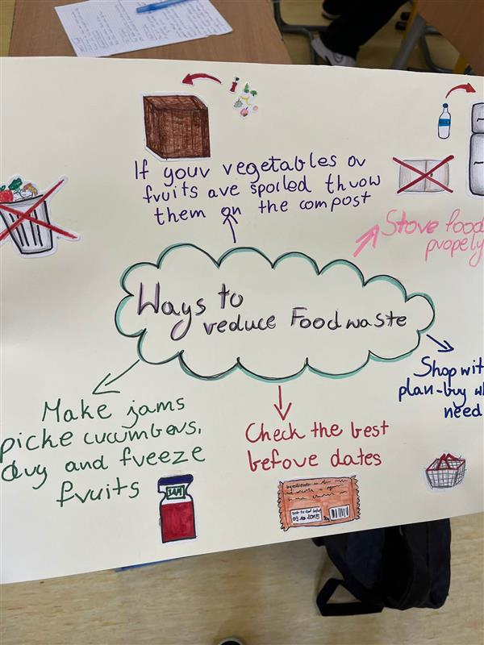
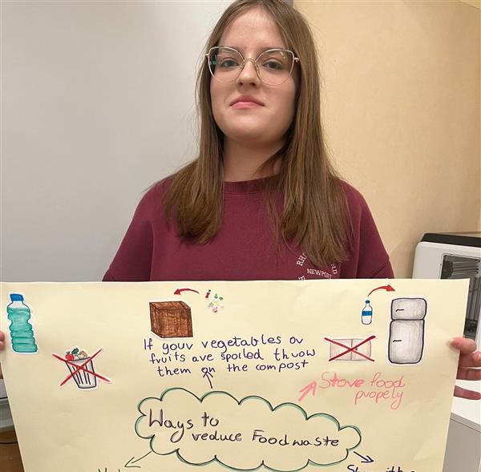
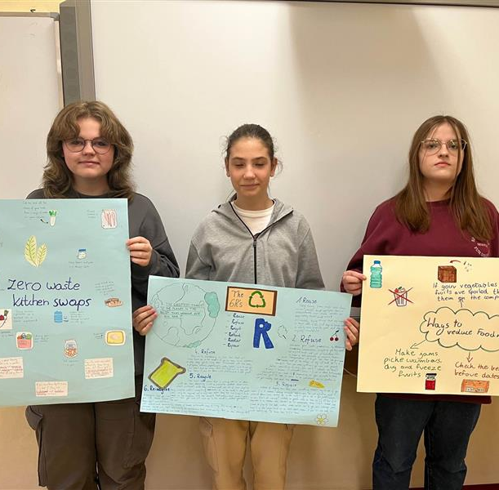
Project work

Slide 6
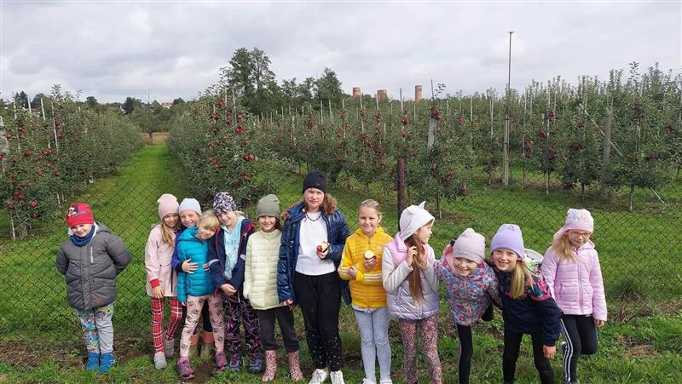
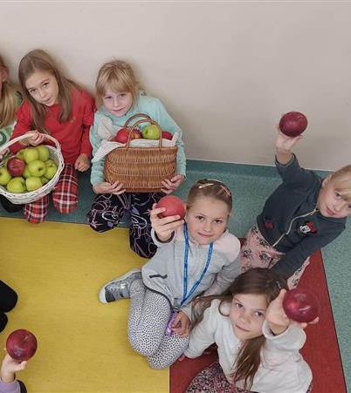
A visit to the apple orchard
The youngest pupils from our school visited an apple orchard where they learnt how to grow the apples and look after them

Slide 7
A visit to the organic farm
7th grade students had a chance to visit an organic farm situated near our school.
The farm is owned by one of our friend's mum.
All you can find there is organic and eco. There are no pesticides and fertilizers used to cultivate the land.

Slide 8
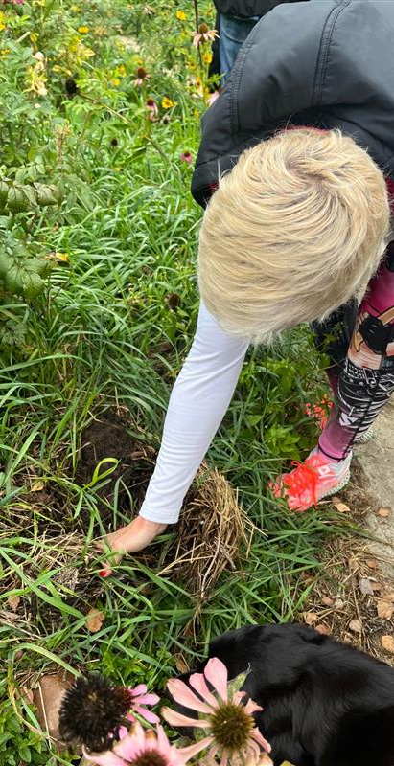
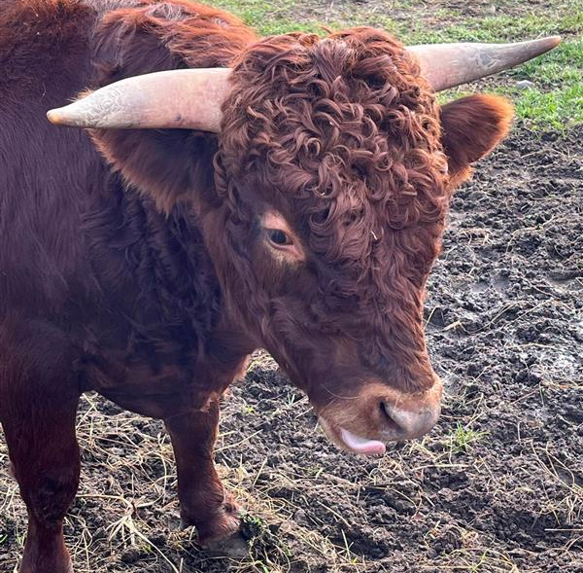
We have found out a lot of interesting facts. Did you know that....?
Worms, animals' poo, banana peels and eggshells are used as the best natural fertilizers
Tomtits feed with pests and predatory insects
Ladybirds eat aphid whereas the aphid doesn't cause any problems on sustainably developed farm
Cats reduce the numbers of rodents and pests on the farm

Slide 9
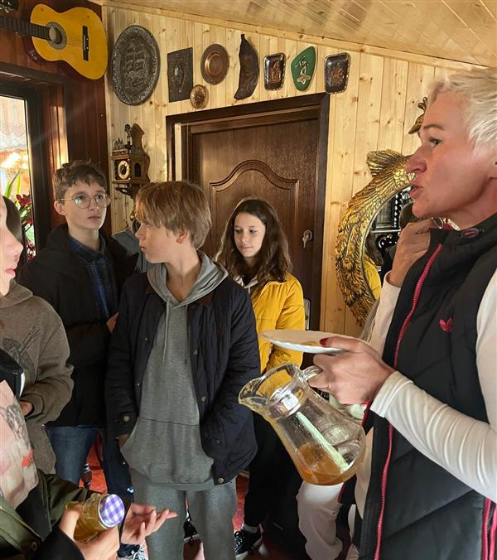
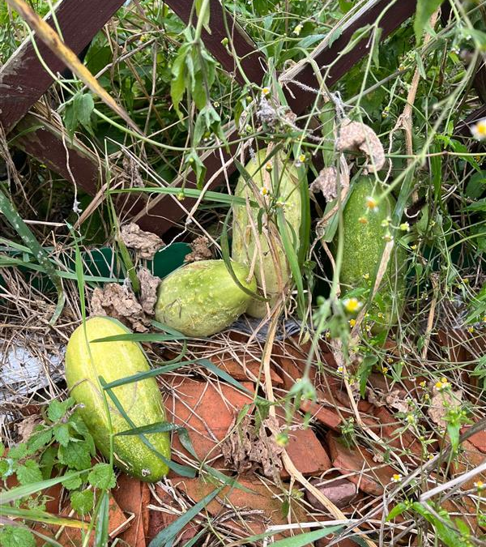
Bees are the most important animals living on the farm, unfortunately killed by pesticides. If a beehive is destroyed, all the bees die.
The rainwater is collected into big containers, then it is used to water the plants
The eco farmhouse is a passive house - it uses little energy to heat it. It is heated by deadwood from the owner's forest
The farm is self sufficient in 90%

Slide 10
Lesson about Biodiversity and Biodegrability
In November, we were visited by the mother of one of the students at our school to tell us a bit about organic food, biodegradability and biodiversity. Mrs. Ania is a lawyer by day, but to reduce her stress, she becomes a farmer- she takes care of her animals and her organic food!
The purpose of establishing such a farm was to help her husband recover from cancer. As some of you know, organic food can greatly improve the condition of a sick person, and even eliminate cancer completely, as in the case of Mrs. Anne's husband. At the beginning of the lesson, we learned what photosynthesis and the biosphere are and how all creatures on earth are able to live. She also gave us a diagram:
H²O+CO²+☀️=O²+glucose
The point in this is that humans breathe, they produce CO², which gets into the plant, which produces oxygen for us.

Slide 11
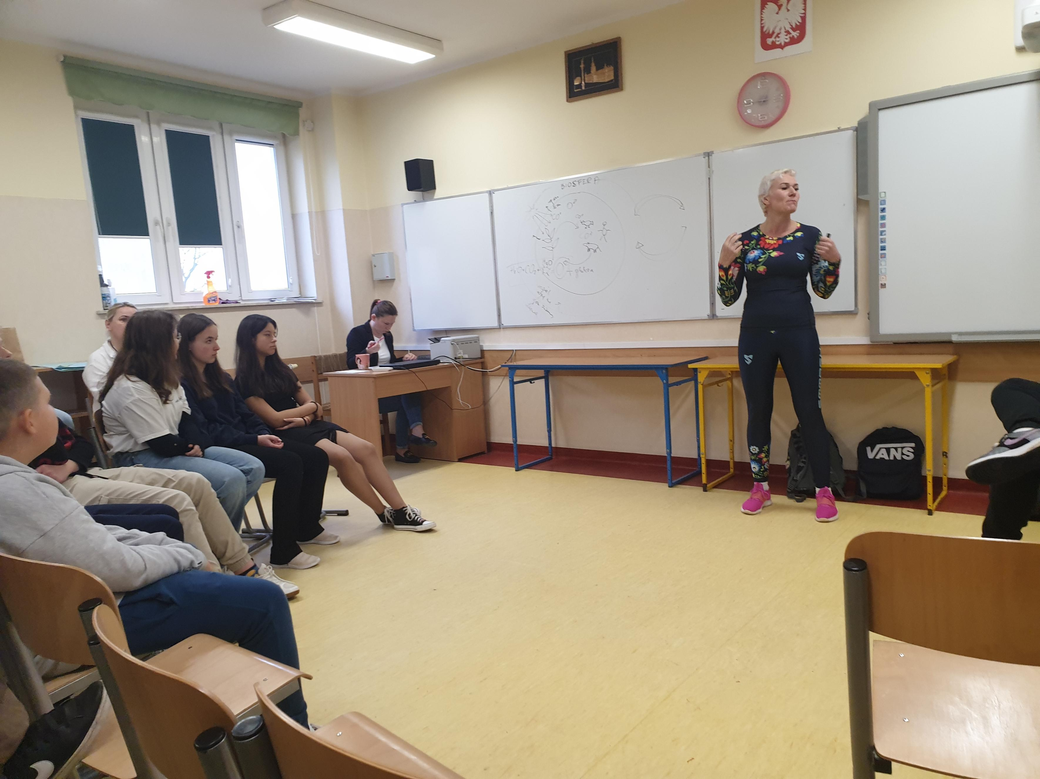
The question we got from Mrs. Anna was ,,how often do you buy a new phone,, most of us answered ,,every 3 years". We were shocked to learn that such a device decomposes up to 1,000,000 years! The next question was ,,how many liters of water do you use for bathing,, we answered ,,about 25 liters" , finding out that the Chinese bathe in only 3 liters of water.
The last thing Mrs. Ania told us was what our diet should look like. It should be ¾ of vegetables or fruit, ¼ of carbohydrates, for example, porridge and meat should only be an addition! At the end, Mrs. Ania gave us 6 most important methods of living in accordance with nature: Rethink, Refuse, Reduce, Reuse, Recycle and Repair

Slide 12
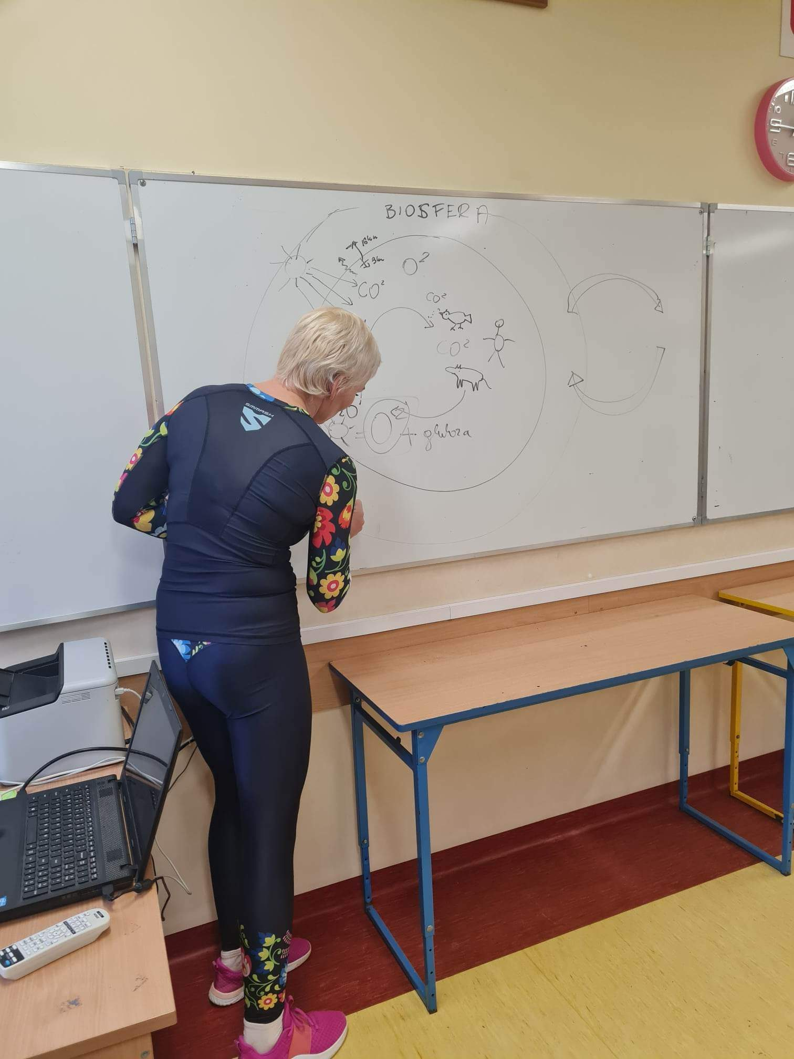
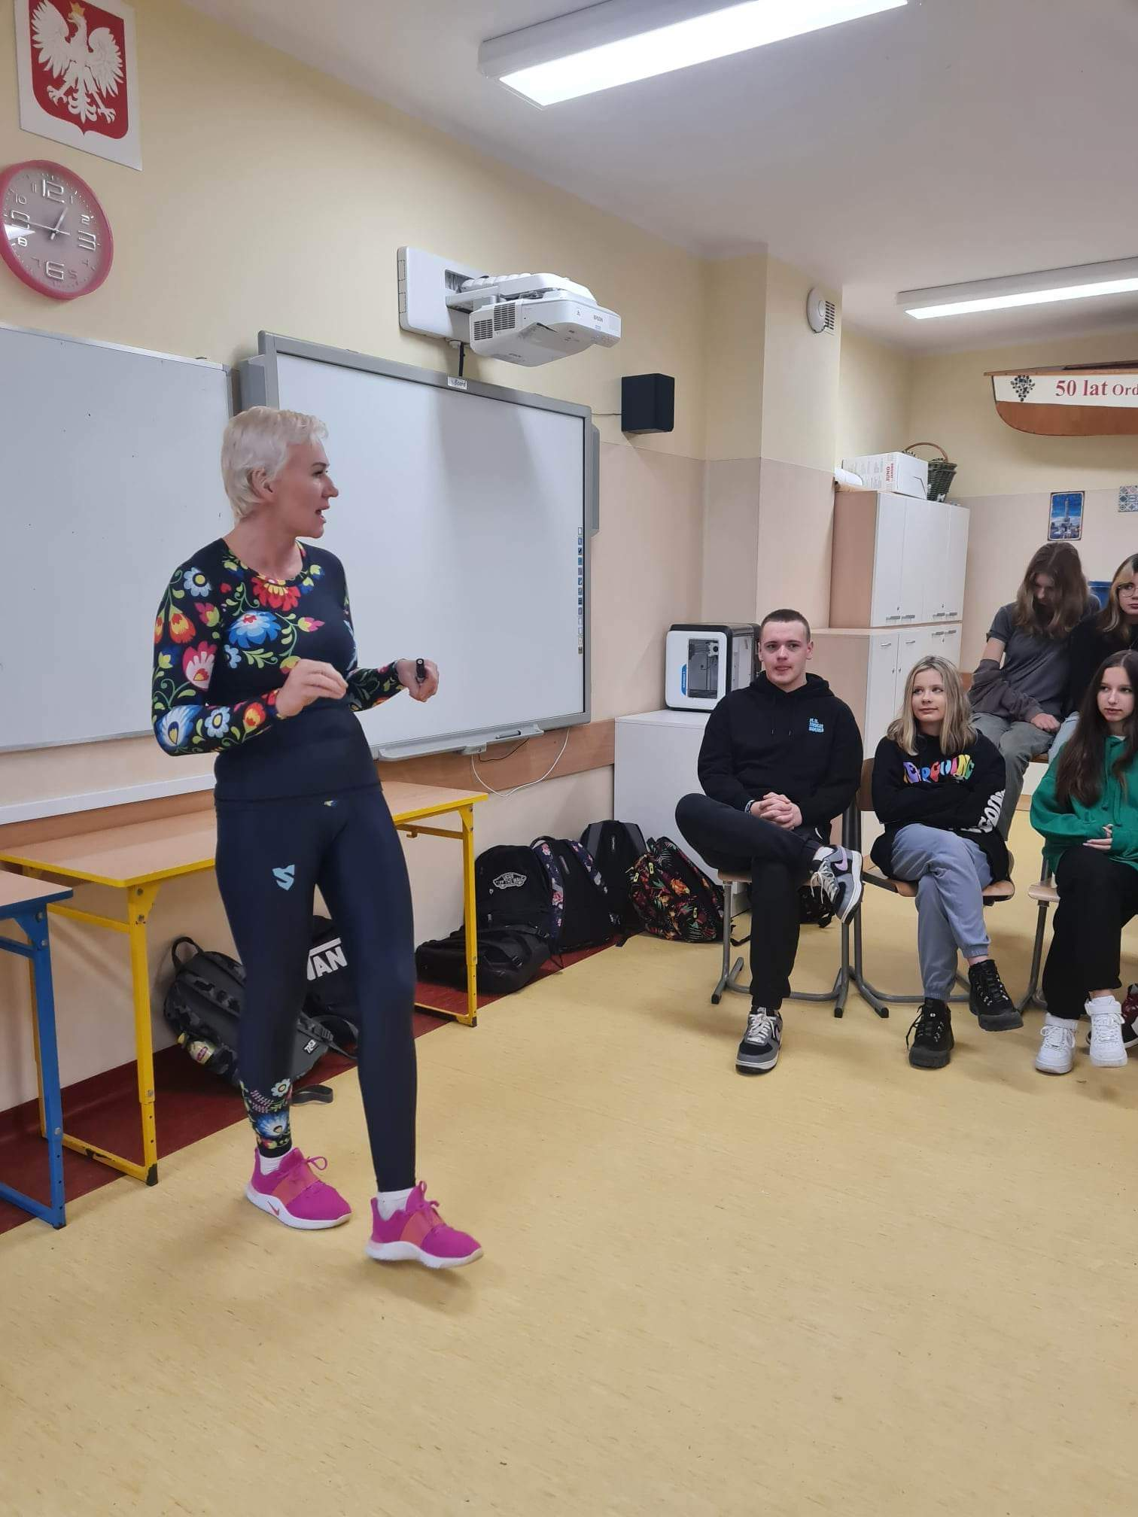
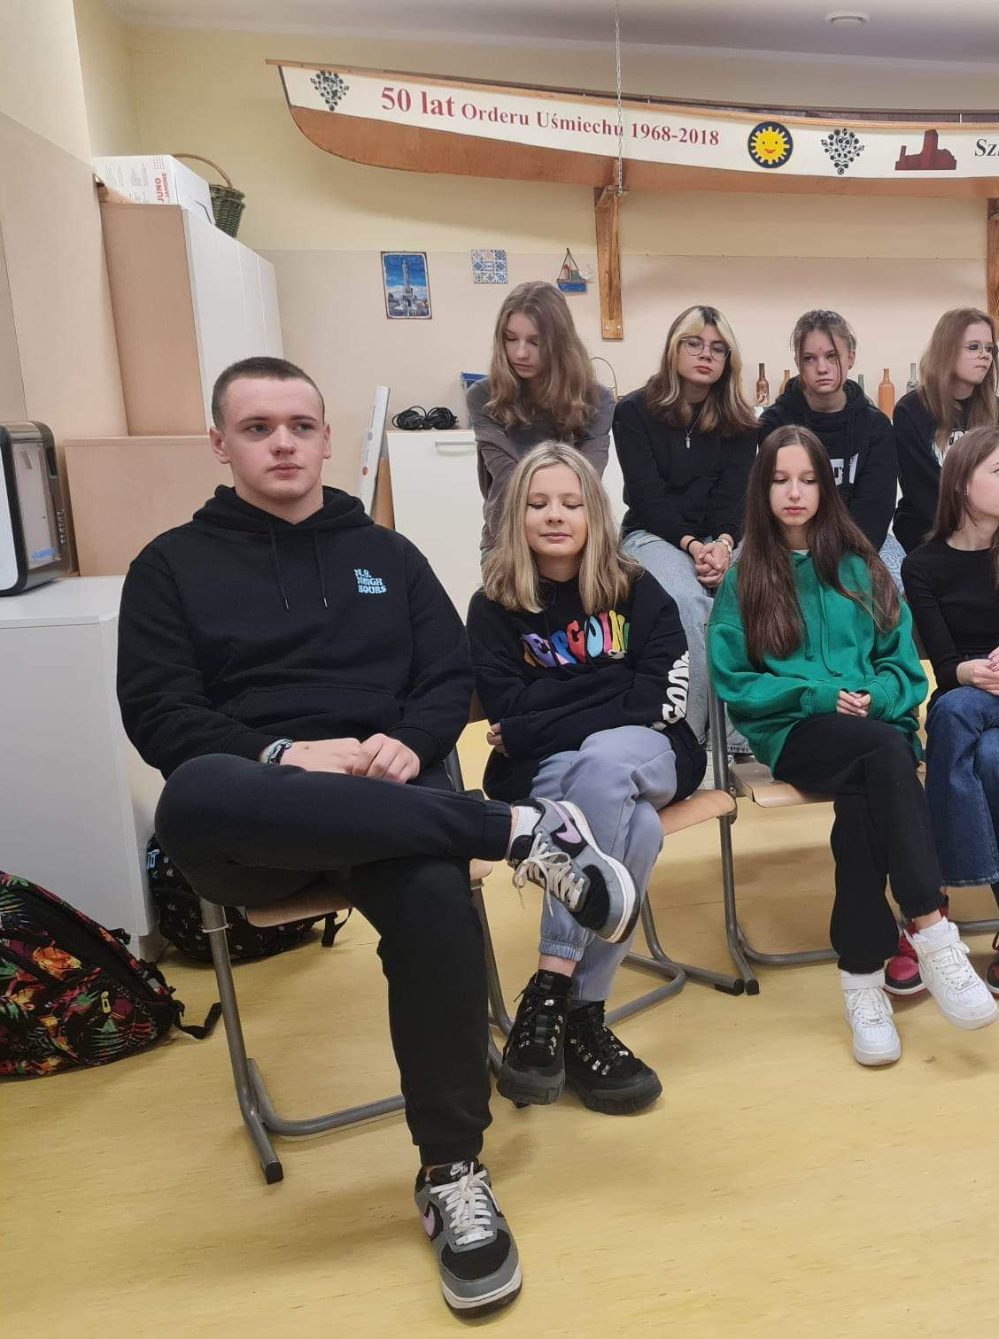
Some photos of us and Mrs. Anna ☺

Slide 13
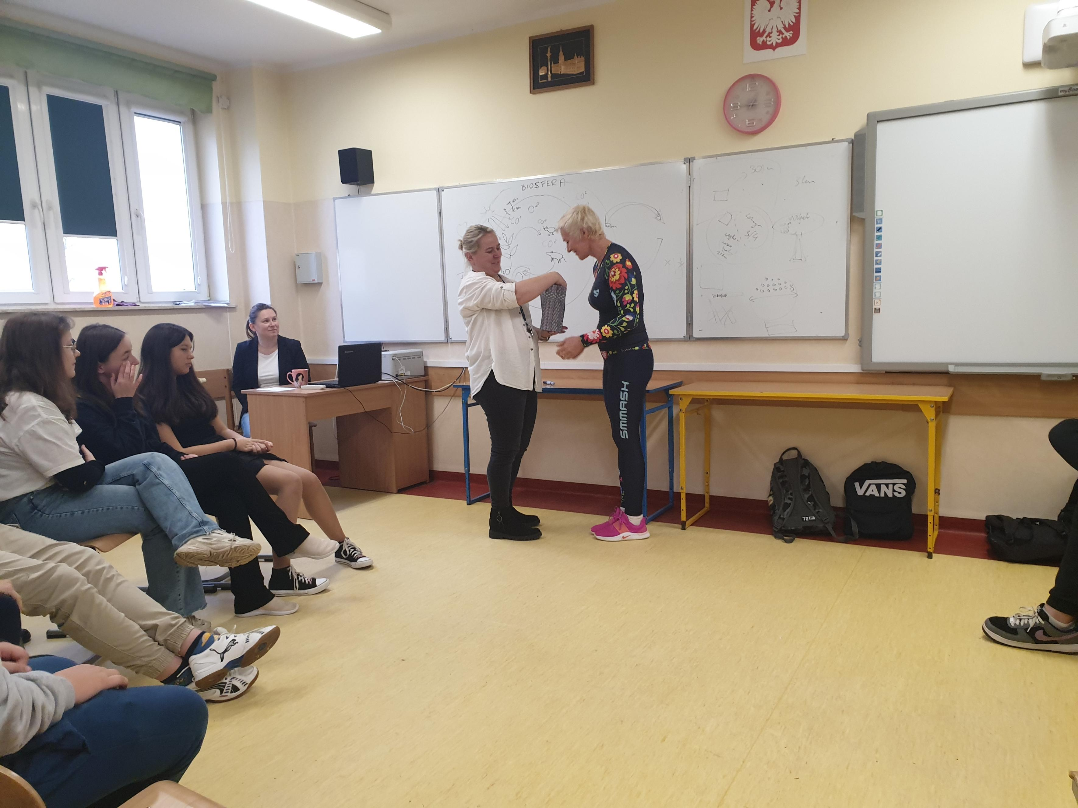
To show how greatful we were, we gave Mrs. Ania a modest gift that she will be able to use on her organic farm ☺

Slide 14
Our visit to the food bank
What are food banks?
Food banks are non-governmental, not-for-profit organizations. Banks do not conduct business activity. The essence of their operation is the use of obtaining food from sources - primarily food that can be damaged or destroyed. Then, before the use-by date, they distribute it to local charities and social aid organizations fighting hunger and malnutrition.

Slide 15
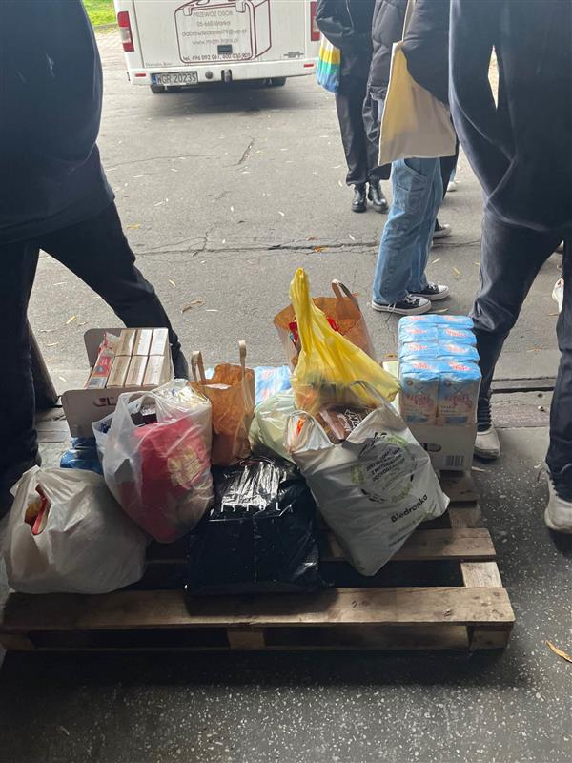
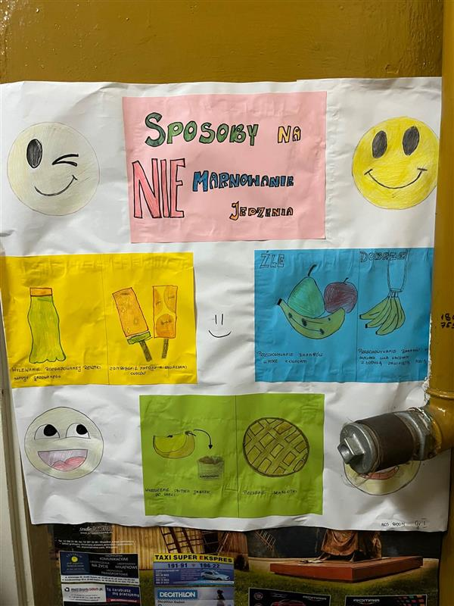
Stop wasting food
Ways to not waste food

Slide 16
What products can be donated to a food bank?
Fresh and seasonal products such as bread, fruit, vegetables
perishable products or products requiring refrigeration, for example yoghurts, cheeses, butter or meat.
durable products, for example pasta, sugar, rice, groats and oils.

Slide 17
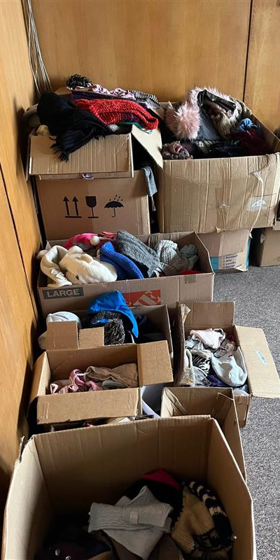
Caritas
What does Caritas do?
It provides emergency and long-term, material and financial assistance to the unemployed, the homeless, the sick, the elderly, children from poor families, as well as immigrants and refugees. Caritas also provides humanitarian aid to victims of wars, natural disasters and natural disasters outside Poland.

Slide 18
Polish Red Cross
The mission of the Polish Red Cross is to prevent human suffering and mitigate its effects, and to protect human dignity, without any discrimination on the basis of nationality, race, gender, religious or political beliefs.

Slide 19
Some other photos
At the end of the trip we got these cute jellyfish

Slide 20
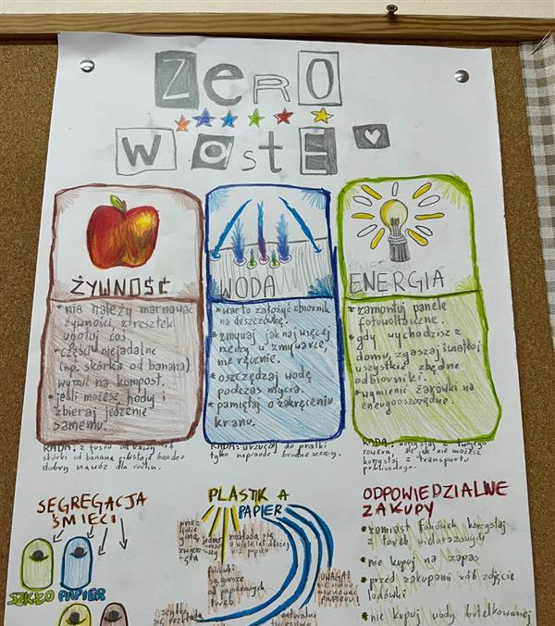
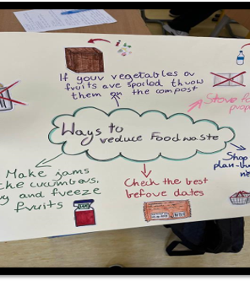
Learning about biodiversity and food waste management
We have discussed the way to reduce foodwaste
We have learnt what to do with the food leftovers and how to manage them at home
We know a lot about the 6Rs which are: reuse, refuse, recycle, rethink, reduce and repair

Slide 21
Ways to reduce foodwaste
Don't miss the expiration date
Store food properly
Plan your purchases
Take a smaller portion
Organize your fridge
Freeze or dry your food to extend its use-by date
Plan your meals

Slide 22
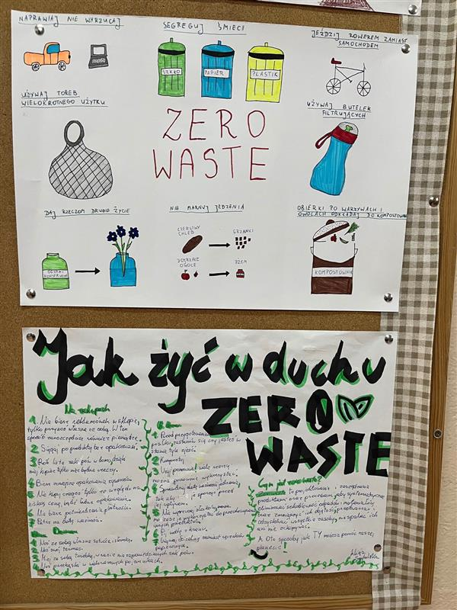
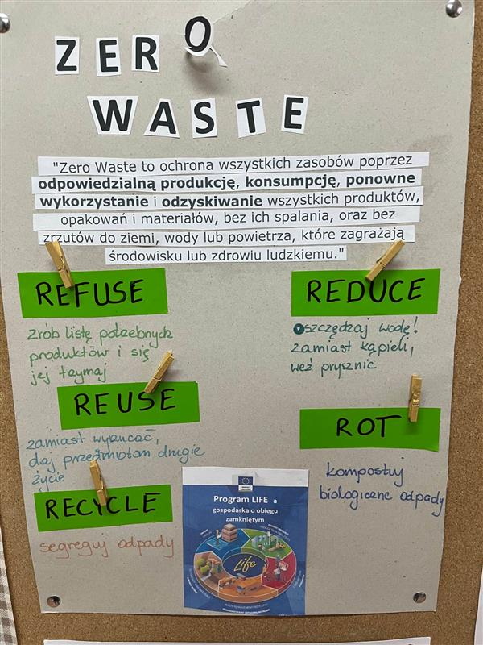
Zero waste projects

Slide 23
Organic food day and healthy breakfast day at our school
We have organized organic food day and healthy breakfast day at our school. Most of the students took part in the event. They brought healthy snacks to school or prepared healthy food with their teachers at school.
The volunteers group from our school prepared organic food day. The money they collected was spent on products which we took to a food bank.

Slide 24
Organic food day

Slide 25
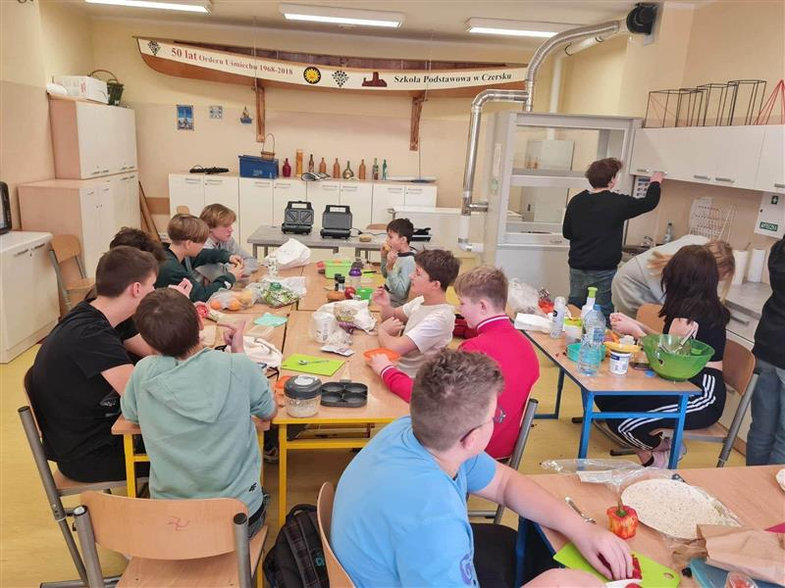
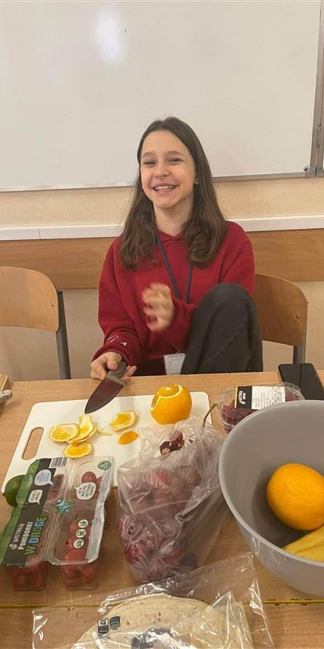
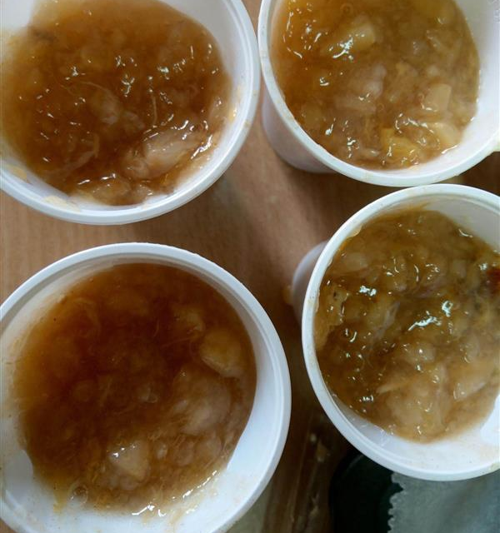
Healthy breakfast day

